Slide 1

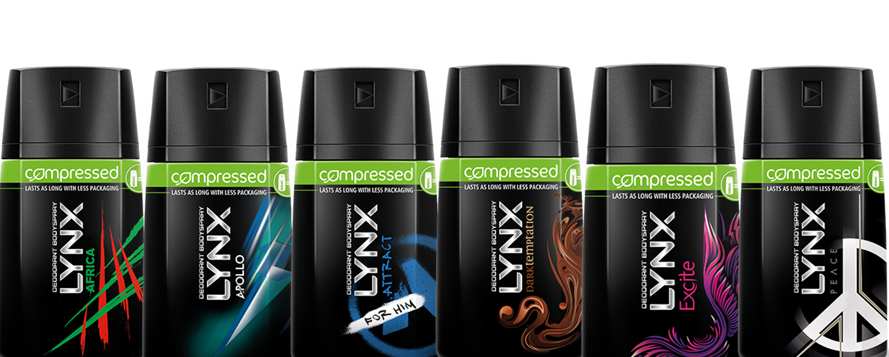
Rachael Maltby
Meagan Kascsak
Kassie Katinas

Slide 2
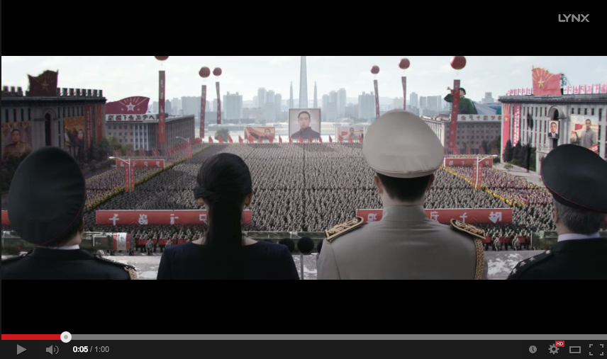
Make Peace. Not War.

Slide 3
History
Launched as Lynx due to trademark issues in the U.K., Ireland, Australia and New Zealand.
Produced by Unilever in 1983
Axe is a popular hair product, body spray and cologne in the United States, also targeted for young men.

Slide 4

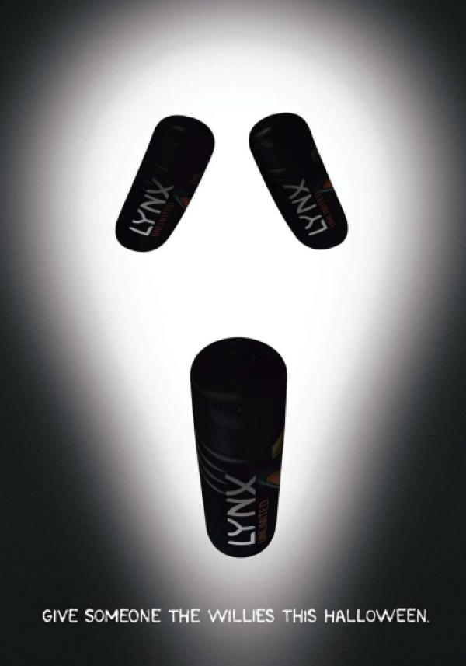

Lynx campaign
Creative

Slide 6


Lynx campaign:
http://www.lynxpeace.com/moments

Slide 7


Axe campaign
Movie promotional campaigns
  X-Men

Slide 9
In conclusion…
Basically the same in U.S. and U.K.
Differ in the amount of sexuality in the advertisements
Social media interaction
  http://www.lynxpeace.com/

Slide 10
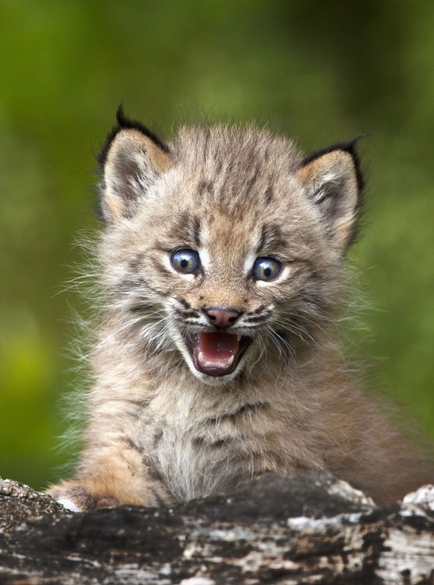
Questions?

